Slide 1


Predicting Sepsis Onset in ICU Patients Using FCNN and Random Forest
Maziyar Mirzaei
UT-Austin 2024
GitHub Link

Slide 2
Project Overview
Objective: Predict the risk of sepsis onset within the ICU stay, focusing on the first 24 hours.
Dataset: MIMIC-III clinical database, containing detailed ICU patient information.
Justification: Early detection and treatment can save lives and reduce complications associated with sepsis.

Slide 3
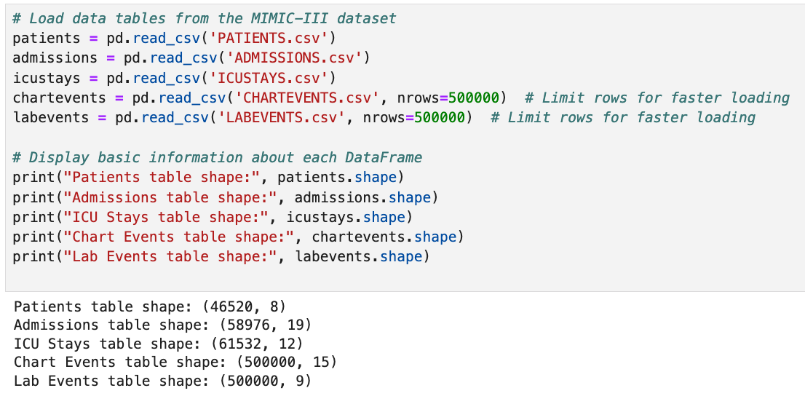
Load the Data
We load only the first 500,000 rows of chartevents and labevents as they large tables. But we can adjust the number of rows based on our computer memeory.
Print the shape of each DataFrame to understand the size of each table.

Slide 4
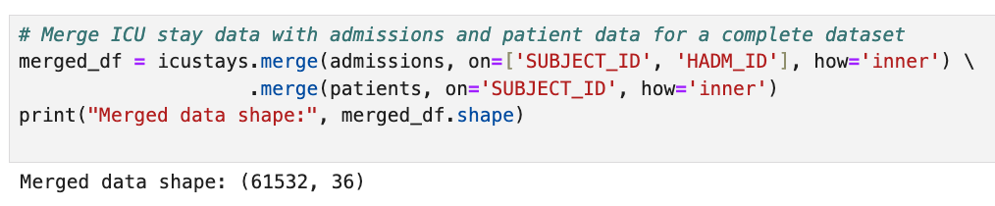
Merge the Data
We’ll need to merge the data to get comprehensive information for each patient in the ICU.
We join icustays with admissions and patients to get each ICU stay’s associated admission and patient info.
This merged DataFrame (merged_df) is the basis for linking ICU stay data with patient demographics and outcomes.

Slide 5
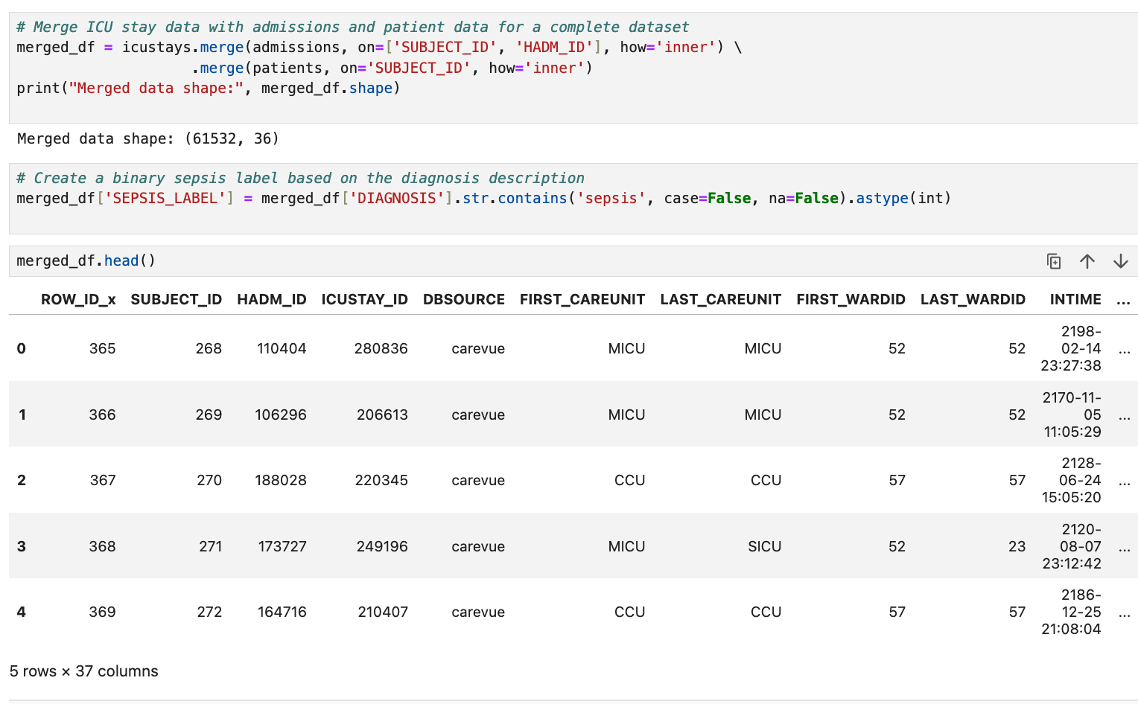
Select Indicators of Sepsis
Identify specific item IDs in chartevents and labevents that serve as sepsis indicators. Here, we’ll use heart rate, blood pressure, temperature, and others. Adjust as per your study requirements
Each ITEMID represents a specific measurement in MIMIC-III (e.g., heart rate, temperature).
We’ll use these values to extract time-series data from the chartevents and labevents tables.

Slide 6
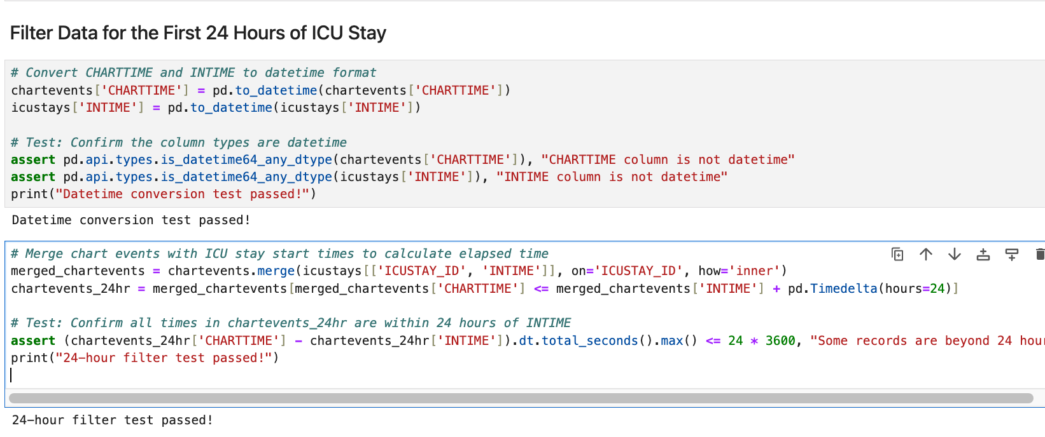
Filter Data for the First 24 Hours of ICU Stay
To predict sepsis early, we’ll focus on data from the first 24 hours of each ICU stay.
We merge chartevents with icustays to get each chart event’s timestamp relative to ICU admission.
Filter chartevents to include only data within the first 24 hours of ICU stay.
Also we write tests to confirm the expected results

Slide 7
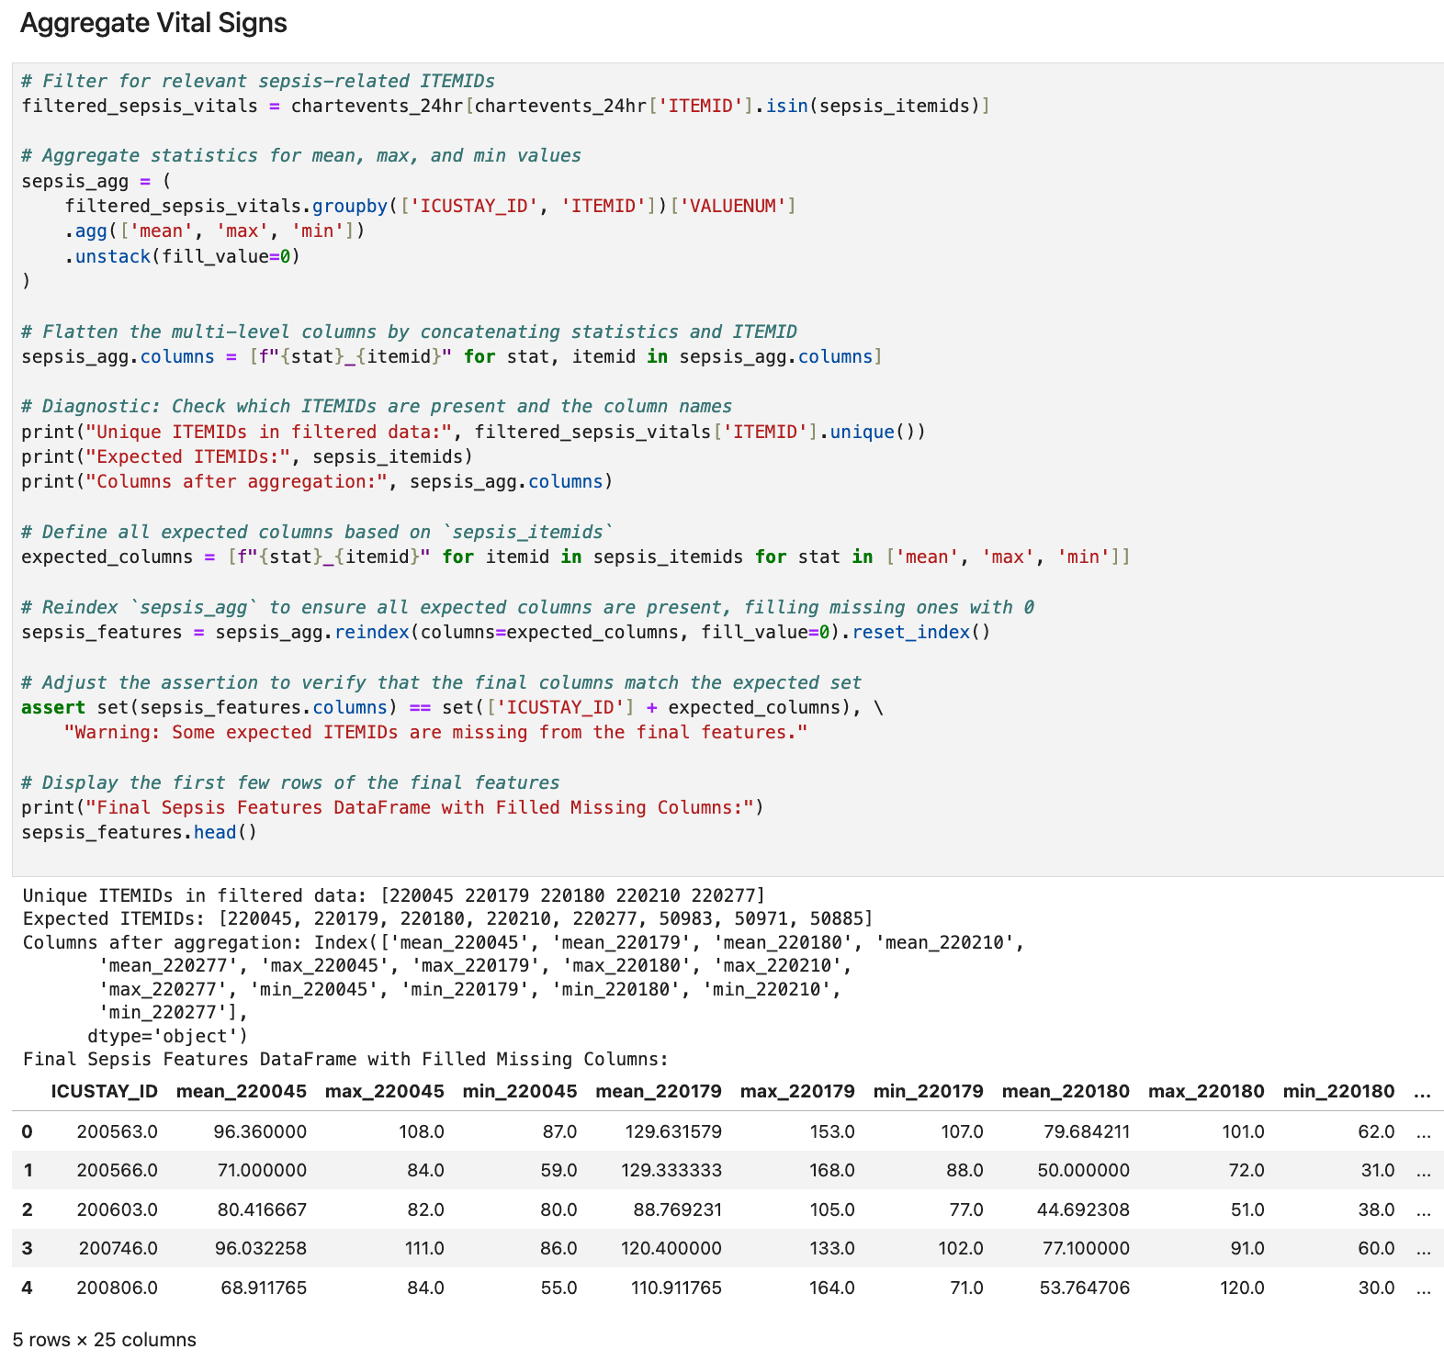
Aggregate Vital Signs
To get a summarized view of the first 24 hours, calculate the mean, maximum, and minimum for each measurement.
We filter chartevents_24hr by sepsis_itemids, focusing only on sepsis-relevant measurements.
Using .pivot(), we create a new DataFrame (sepsis_features) with each ICU stay as a row and features as columns.

Slide 8
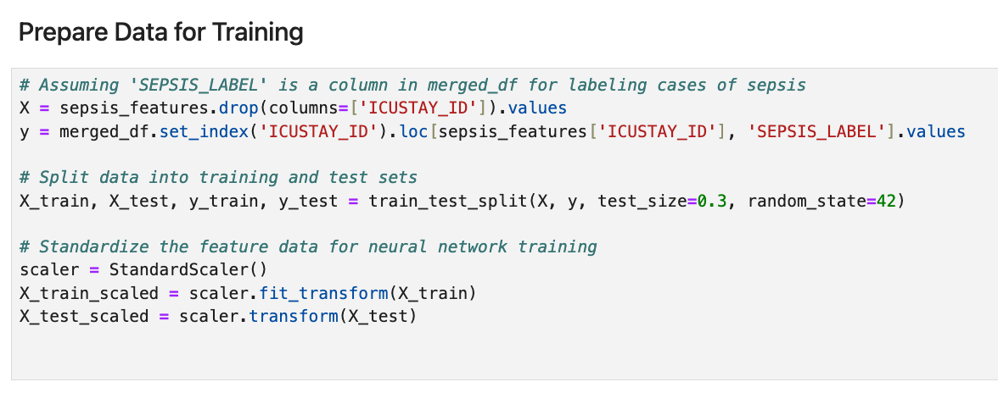
Prepare Data for Training
Define the target variable and split the data into training and test sets.
X contains features for each ICU stay; y is the binary target (e.g., sepsis onset).
train_test_split separates data for model training and evaluation.
StandardScaler scales X values for better neural network performance.

Slide 9
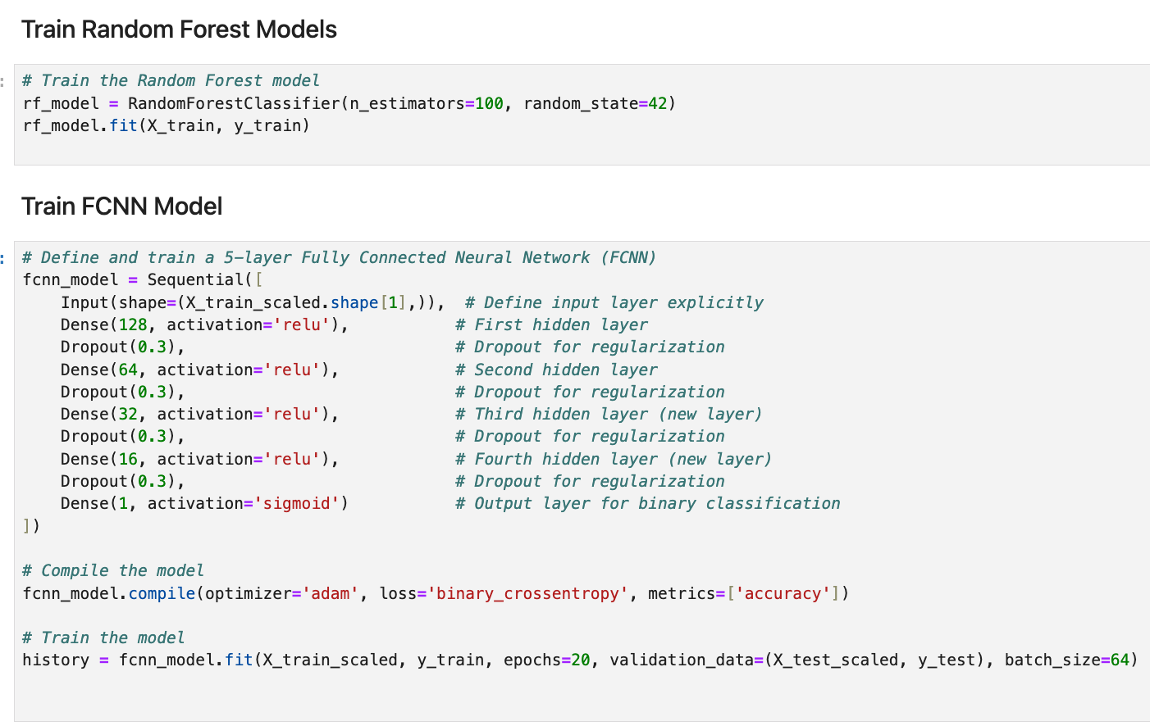
Train Models
We train two models and compare them in terms of accuracy :
Random Forest and a Fully Connected Neural Network.
RandomForestClassifier is a powerful, interpretable model.
fcnn_model is a neural network with five hidden layers and dropout for regularization.

Slide 10
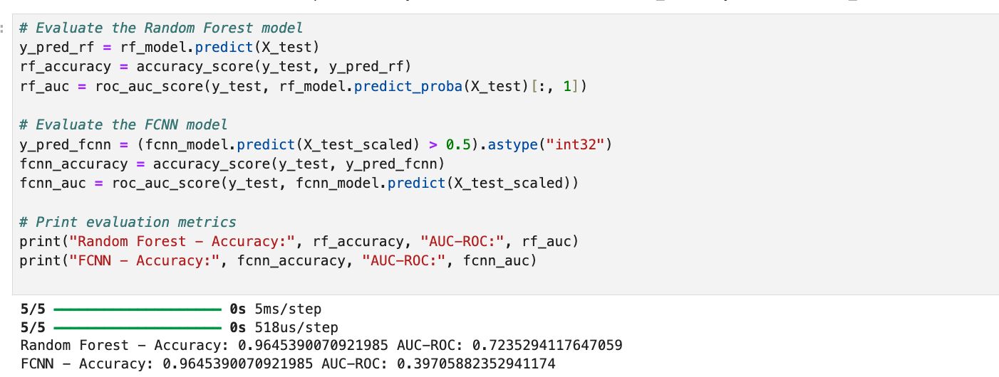
Evaluate Models
We use accuracy and AUC-ROC for evaluation.
We calculate accuracy and AUC-ROC to gauge model performance.
AUC-ROC provides insight into how well the model differentiates between sepsis and non-sepsis cases.
Based on the output:
Random Forest Model: Achieved an accuracy of 0.965 and an AUC-ROC of 0.724.
This indicates good accuracy, but the AUC-ROC suggests that the model struggles to separate positive and negative cases as effectively as desired.
FCNN Model: Shows an accuracy of 0.965 (same as Random Forest), but a lower AUC-ROC of 0.397.
The lower AUC-ROC (below 0.5) suggests that the model’s predictions are not reliably distinguishing between the classes, indicating issues with the FCNN's ability to separate positive and negative cases in a meaningful way, despite the high accuracy.

Slide 11
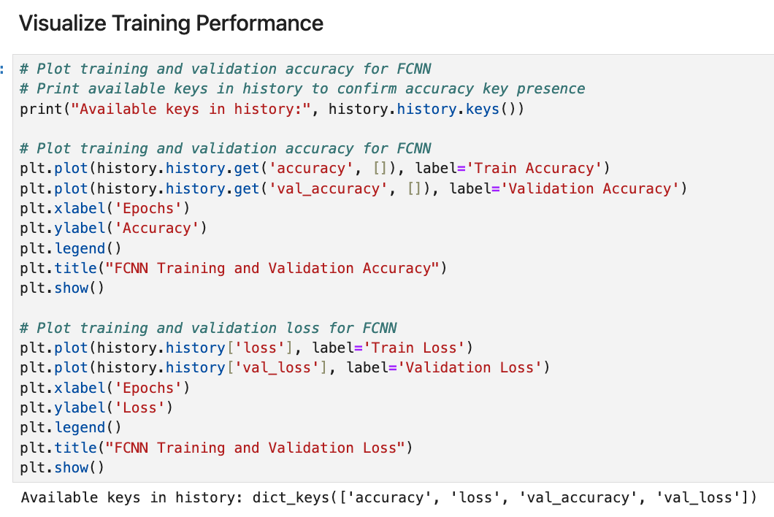
Visualize Training Performance
For neural networks, visualize training history to monitor overfitting or underfitting.

Slide 12
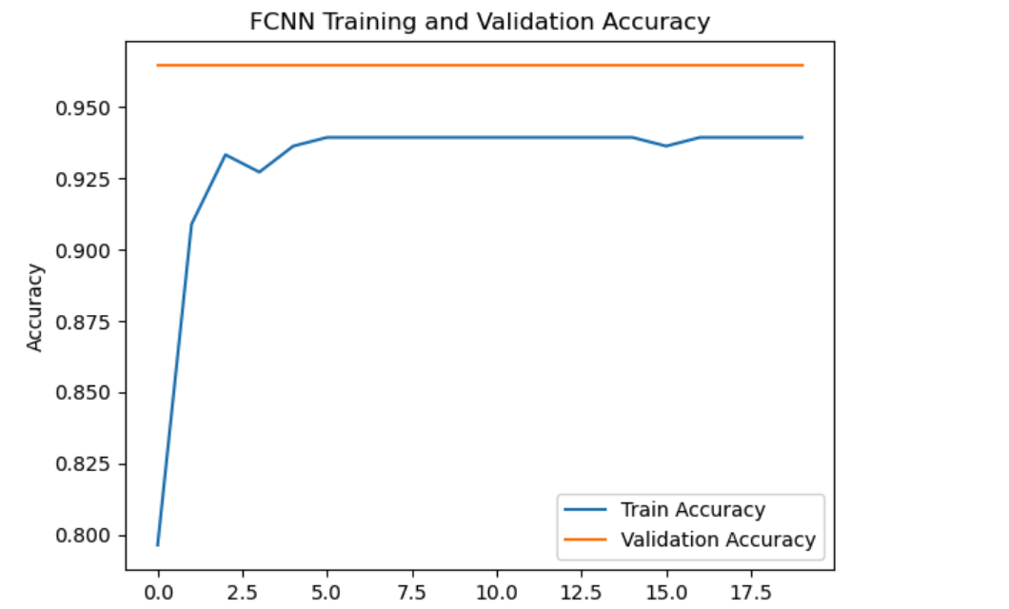
FCNN Training and Validation Accuracy
This graph displays the model's accuracy on both training and validation data across each epoch during training.
Training Accuracy (Blue Line): Shows how well the model fits the training data over time.
Validation Accuracy (Orange Line): Indicates the model's performance on unseen data (validation set) as training progresses.
Observation:
The training accuracy starts low and gradually improves, stabilizing around 95-97%, which indicates that the model is learning to classify well on the training data.
The validation accuracy quickly reaches a high value and plateaus, suggesting that the model generalizes well to validation data.

Slide 13
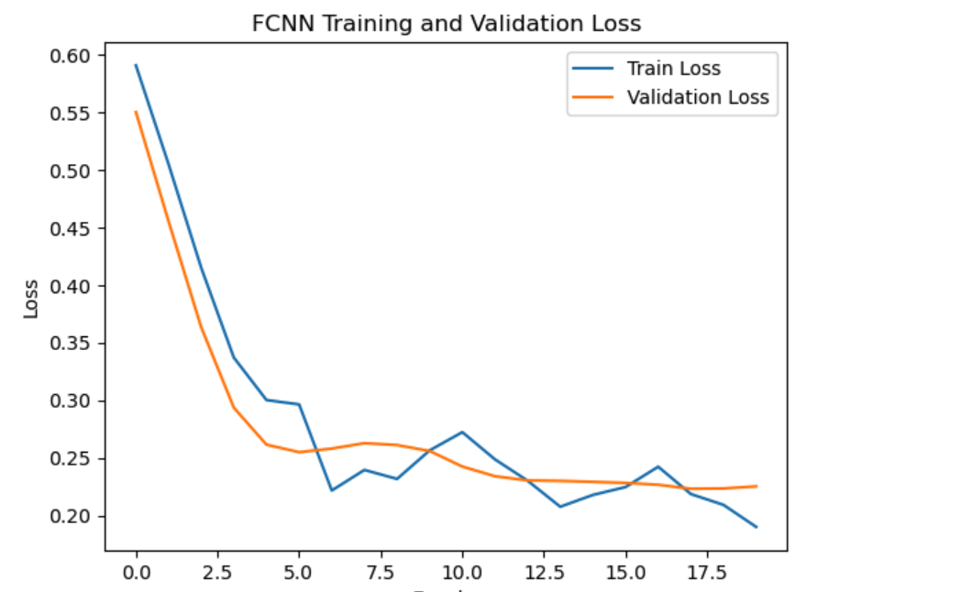
FCNN Training and Validation Loss
This graph illustrates the loss on both training and validation data for each epoch.
Training Loss (Blue Line): Represents the model's error on the training data over time.
Validation Loss (Orange Line): Shows how the model performs on unseen data (validation set) in terms of error.
Observation:
The training loss decreases over time, showing that the model is minimizing its error on the training data as expected.
The validation loss follows a similar trend but plateaus as training progresses, indicating that the model is not significantly overfitting.
Both the training and validation loss stabilize at low values, which aligns with the high accuracy observed in the accuracy graph.

Slide 14
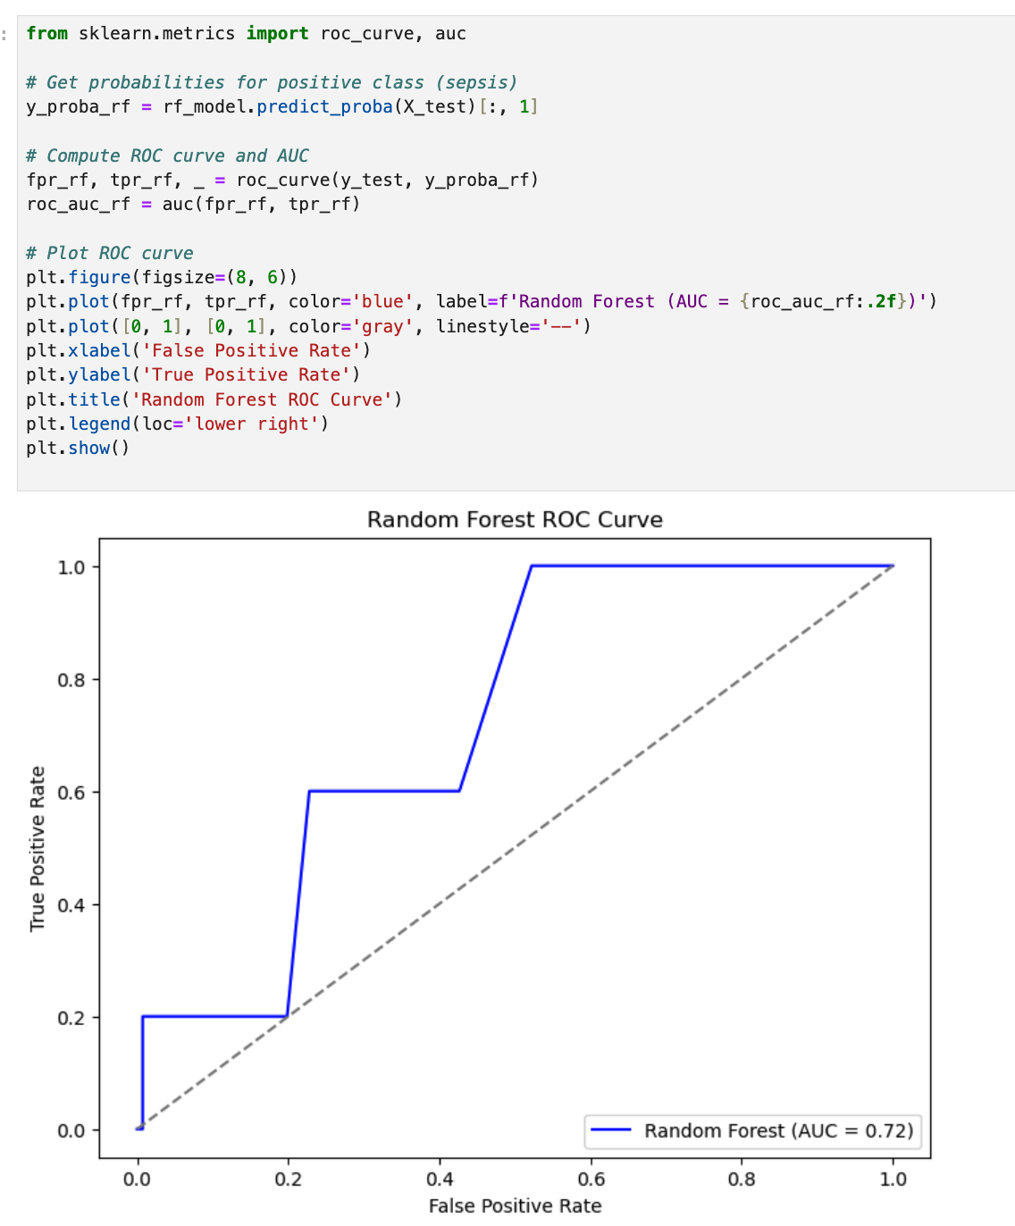
Random Forest ROC Curve for Sepsis Prediction
ROC Curve (Receiver Operating Characteristic Curve):
The ROC curve is a graphical plot that illustrates the diagnostic ability of a binary classifier as its discrimination threshold is varied.
In this graph, the True Positive Rate (Sensitivity) is plotted against the False Positive Rate (1 - Specificity).
The blue line represents the ROC curve for the Random Forest model.
AUC (Area Under the ROC Curve):
The AUC score, shown as 0.72, represents the model's ability to distinguish between sepsis and non-sepsis cases.
An AUC of 0.72 indicates that the Random Forest model has moderate predictive power, successfully identifying sepsis cases 72% of the time when given randomly chosen positive and negative cases.

Slide 15
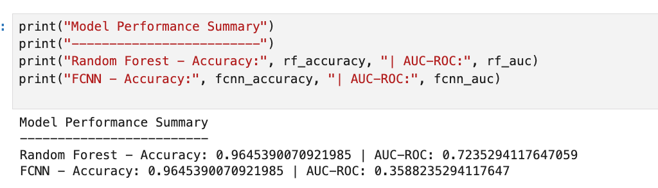
Model Performance Summary
Random Forest Model:
Accuracy: 96.45%
AUC-ROC: 0.72
Fully Connected Neural Network (FCNN):
Accuracy: 96.45%
AUC-ROC: 0.36
Key Takeaways:
Both models achieved similar high accuracy.
Random Forest had a higher AUC-ROC, indicating better performance in distinguishing between classes.
FCNN’s low AUC-ROC suggests that it may not effectively separate positive and negative classes, despite its high accuracy.

